Slide 1

DATABASE TECHNOLOGY BCSC 0165 Database Languages

Slide 2
Converting ER Diagrams to Tables-
ER diagram is converted into the tables in relational model.
This is because relational models can be easily implemented by RDBMS like MySQL , Oracle etc.

Slide 3
Rule-01: For Strong Entity Set With Only Simple Attributes-
A strong entity set with only simple attributes will require only one table in relational model.
Attributes of the table will be the attributes of the entity set.
The primary key of the table will be the key attribute of the entity set.

Slide 4
Rule-02: For Strong Entity Set With Composite Attributes-
A strong entity set with any number of composite attributes will require only one table in relational model.
While conversion, simple attributes of the composite attributes are taken into account and not the composite attribute itself.

Slide 5
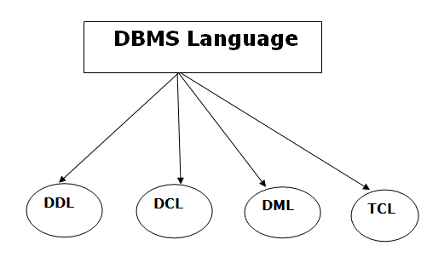
Database Language

Slide 6
1. Data Definition Language
Define database structure.
It is used to create,
Schema, tables, indexes, constraints, etc.
in the database.
Used to store the information of metadata
Metadata
the number of tables and schemas,
their names,
indexes,
columns in each table,
constraints, etc.

Slide 7
Tasks that come under DDL
These commands are used to update the database schema that's why they come under Data definition language.
Create: It is used to create objects in the database.
Alter: It is used to alter the structure of the database.
Drop: It is used to delete objects from the database(removes structure).
Truncate: It is used to remove all records from a table (structure remains same).
Rename: It is used to rename an object.
Comment: It is used to comment on the data dictionary.

Slide 8
2. Data Manipulation Language
It is used for accessing and manipulating data in a database.
It handles user requests.
Select: It is used to retrieve data from a database.
Insert: It is used to insert data into a table.
Update: It is used to update existing data within a table.
Delete: It is used to delete few(based on condition)/all records from a table(structure remain same).

Slide 9
3. Data Control Language
The DCL execution is transactional.
Tasks that come under DCL:
Grant: It is used to give user access privileges to a database.
Revoke: It is used to take back permissions from the user.

Slide 10
4. Transaction Control Language
TCL is used to run the changes made by the DML statement.
TCL can be grouped into a logical transaction.
Tasks that come under TCL:
Commit: It is used to save the transaction on the database.
Rollback: It is used to restore the database to original since the last Commit.

Slide 11
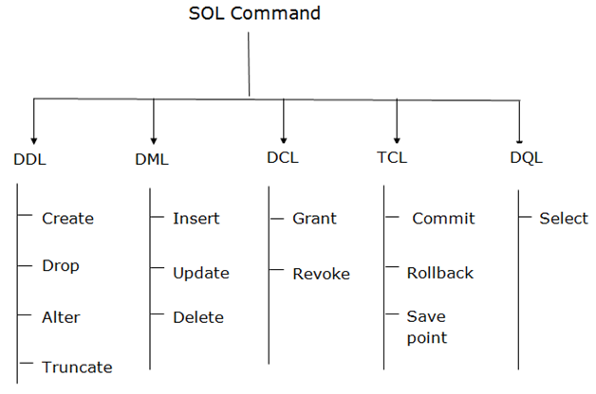

Slide 12
Question ?
Drop vs Delete vs Truncate……..?

Slide 13
Drop vs Delete vs Truncate
Delete | Truncate | Drop
DML | DDL | DDL
Removes few or all records | Removes all record | Removes table
No change in structure | No Change in structure | Change in structure
May use where clause | Not used | Not used
Can be rollback | Can’t rollback | Can’t rollback
Slower than truncate | Faster than Delete | Faster than Delete

Slide 14
Thank You

Slide 15
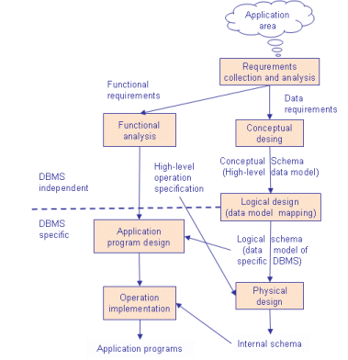
Design Phases
Notes:
Database design is connected with application design. The requirements and the collection analysis phase produce both data requirements and functional requirements. The data requirements are used as a source of database design. The data requirements should be specified in as detailed and complete form as possible. In parallel with specifying the data requirements, it is useful to specify the known functional requirements of the application. These consist of user-defined operations that will be applied to the database (retrievals and updates). The functional requirements are used as a source of application software design. Of course some functions may produce also needs for database design. Note that some phases are database management system independent and some are dependent. The idea is to design first the database without thinking about the actual database system - just to concentrate on the data

Slide 16
Design Phases
Conceptual Design Once all the requirements have been collected and analyzed, the next step is to create a conceptual schema for the database, using a high level conceptual data model. The result of this phase is an Entity-Relationship (ER) diagram or UML class diagram. It describes how different entities (objects, items) are related to each other. It also describes what attributes (features) each entity has. It includes the definitions of all the concepts (entities, attributes) of the application area. During or after the conceptual schema design, the basic data model operations can be used to specify the high-level user operations identified during the functional analysis. This also serves to confirm that the conceptual schema meets all the indentified functional requirements.
Input: Data Requirements Output: ER Diagram

Slide 17
Design Phases
2. Logical Design The result of the logical design phase (or data model mapping phase) is a set of relation schemas. The ER diagram or class diagram is the basis for these relation schemas. To create the relation schemas is quite a mechanical operation. There are rules how the ER model or class diagram is transferred to relation schemas. The relation schemas are the basis for table definitions. In this phase (if not done in previous phase) the primary keys and foreign keys are defined.
Input: ER Diagram Output: Relation Schemas

Slide 18
Design Phases
Normalization Normalization is the last part of the logical design. The goal of normalization is to eliminate redundancy and potential update anomalies. Redundancy means that the same data is saved more than once in a database. Update anomaly is a consequence of redundancy. If a piece of data is saved in more than one place, the same data must be updated in more than one place. Normalization is a technique by which one can modify the relation schema to reduce the redundancy. Each normalization phase adds more relations (tables) into the database.
Input: Relation Schemas Output: Refined Relation Schemas

Slide 19
Design Phases
Physical Design The goal of the last phase of database design, physical design, is to implement the database. At this phase one must know which database management system (DBMS) is used. For example, different DBMS's have different names for datatypes and have different datatypes. The SQL clauses to create the database are written. The indexes, the integrity constraints (rules) and the users' access rights are defined. Finally the data to test the database is added in. In parallel with these activities, application programs are designed. The implementation of the programs can start when the database is created and data has been added in.
Input: Refined Relation Schemas Output: Implement the database

Slide 20
Design Phases
Initial phase -- characterize fully the data needs of the prospective database users.
Second phase -- choosing a data model
Applying the concepts of the chosen data model
Translating these requirements into a conceptual schema of the database.
A fully developed conceptual schema indicates the functional requirements of the enterprise.
Describe the kinds of operations (or transactions) that will be performed on the data.

Slide 21
Design Phases (Cont.)
Final Phase -- Moving from an abstract data model to the implementation of the database
Logical Design – Deciding on the database schema.
Database design requires that we find a “good” collection of relation schemas.
Business decision – What attributes should we record in the database?
Computer Science decision – What relation schemas should we have and how should the attributes be distributed among the various relation schemas?
Physical Design – Deciding on the physical layout of the database
Notes:
21

Slide 22
Thank You

